Slide 1
Single Design
DH 3264 – Derivatives OTC Customer Phase 1
Template Version: 1.3
December 08, 2025

Slide 2
Version Control
Version | Date | Description | Author
0.1 |  | Document ready for Architecture approval | Domingo Megía,

Slide 3
Index
1.Funcional Design
  1.1 Introduction & Goals
  1.2 As Is – Macro Architecture
  1.3 Principles
  1.4 To Be – About the Solution / Solution Strategy
  1.5 Application Impact Analysis / Dependencies
  1.6 AI Projects
2.Technical Design
  2.1 Architectural Building Blocks
  2.2 Technical View
  2.3 Deployment View
  2.4 Runtime View / Sequence Diagram
  2.5 Integration – Message/Traffic Flow
  2.6 Third Party Connectivity Information
  2.7 Data Flow
  2.8 Integration – APIs
  2.9 Applications
  2.10 User Management
  2.11 Security Architecture Diagram - Target
  2.12 New Technologies
  2.13 Public Cloud Native Services
3. Process Design
  3.1 Process Objective
  3.2 Process Roles / RACI
  3.3 Process Flowchart
4. Infrastructure Requirements
  4.1 Volumes
  4.2 Data Sizing Information
  4.3 Data Handling Information
  4.4 Reporting
  4.5 Workstation Requirement
  4.6 Application Availability
  4.7 Infrastructure Components
  4.8 CaaS Infrastructure
  4.9 Special Requirements
  4.10 Cyber Resiliency - Application Level
  4.11 References

Slide 4
Functional Design
01

Slide 5
Functional Design
1.1 Introduction & Goals
1.1. Project Information
Delivery Hub ID/MEGA ID | #Delivery Hub: 3264. MEGA:T24 – MEGA ID: 1937 & Murex 3 Latam MEGA ID: 3493
Delivery Hub Project Name: | DH 3264 – Derivatives OTC Customer Phase 1 // NDF
Hiperos ID | R21231
Entities in Scope: | Product to be implemented ONLY for BSI Miami. It requires other entities intervention. Integration with Santander Global Tech & Operations (Santander Group) required. T24-Murex using same connection as FX. Asset Control – T24 using same connection as FX. BSI User accessing to MOI Reports app required. BSI should be setup as consumer. Existing App in MEGA (consumed already by other US entities in the group). BSI user accessing to PIF is required. Existing APP in Global (APM) but it does not exist in MEGA. New setup in MEGA done (MEGA ID# 7791) by BSI. Update of connectivity (ports and server) with DTCC (existing for FX product but obsolete) required.
Project Objective: (Attach Business Requirements Document) | It aims to establish a full e2e process and a control framework to allow BSI Miami to offer Non-Delivery-Forwards (NDF) to their client as part of their product Catalogue. BRD provided in Delivey Hub and cybersecurity tickets.
Business Owner: | Business Owner: Ted Fernández
IT Owner: | Jose Luis Martinez Avial
ARB Criteria
> 2 MM | No
Cross Functional | No
New Technology | No
Strategy New Application | No
Miscellaneous Request | No
Cloud Deployment | No (SaaS affiliate)
AI or Quantum Computing | No
Alexandria Project Classification | Local
Aligned with Global Tech Stack / Global Platforms | Yes

Slide 6
Functional Design
1.1 Introduction & Goals
Introduction / AsIs
N/A. This product does not exist as of today
Goal/Objective of the project
The project’s goal is to create a new revenue stream for BSI by offering this new product to clients.
Provide a list of Stakeholders (optional if captured in Macro Architecture document):
  Treasury: Ricardo Valdivia, Alexander Falcon, Johny Alexander Prada Gomez,
  Risk: Macarena Porrero, Lorenzo Vaiani
  Product Support: Judy Morel
  Compliance: Fernando Herrera, Jimena Pérez
  Legal: Hugo Sueiro
  Operations: Rafael Suarez, Michelle Oropesa, Lourdes Cravello, Aaron Ackerman,
  IT: Guillermo Sánchez. Jinen Andee, Ahamed Shanavaz.
  Finance: Sadis Avarenga, Robert Nichols, Marleni Vera, Dunia Gonzalez.
List of RELEVANT Functional Requirements and Non-Functional Requirements (ordered by priority). You can use: ISO standard 25010 or Arc42. Maybe add a Use Case Diagram:
All requirements were described extensively in deliverables submitted during GATE 3 and GATE 4 of Delivery Hub, espectiall in the official BRD document for this project signed off by the Business Sponsor

Slide 7
Functional Design
1.2 As Is – Macro Architecture
Complete this section with the existing Architecture Diagrams that describes the Current Situation.
If there is no architecture diagram available, a High Level “Environment Diagram” should be developed following the Target Architecture look and feel (described in this document).
Non-applicable since this is not an existing product in BSI catalogue. New architecture (very similar to FX architecture and leveraging in some connectivities in place for FX)

Slide 8
Functional Design
1.3 Principles
Principle | Description
Application should be multi-entity (SHUSA) or Regional (North America) | Only BSI Miami.
It should handle Multiple Currency | NDF product is based on currencies. Currencies pairs in scope: USD/PEN, USD/CLP, USD/BRL, USD ARS, USD/COP
Business Logic should be designed and implemented Regardless of the Channels. | Operations should be able to be consumed by all Channels.
The Application should be able to handle Multi-Language | Only English or the application should be able to render in other languages.
The Application should be able to run 24 hours x 7 days
Comply with all regulations. | Storage, administration, provisioning and analysis of the data should comply all the regulations, policies, standards and procedures.
Information Security | Data at rest and Data at transit should be encrypted.

Slide 9
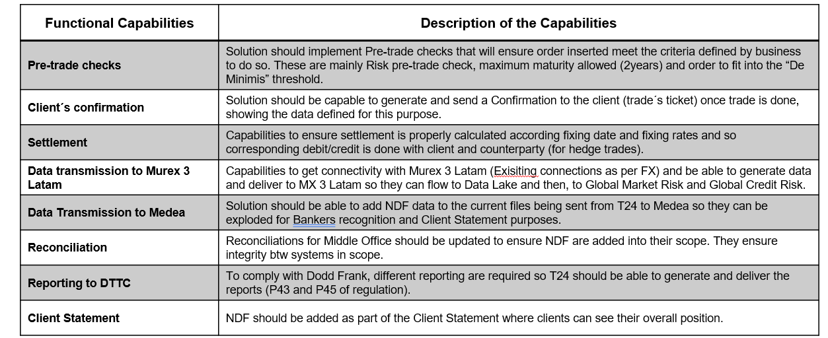
Functional Design
1.4 To Be – About the Solution / Solution Strategy
About the Solution: All business requirements are described in detail in the project’s BRD.
Solution Strategy
Implementation of NDF product in BSI Miami require the implementation of a new T24 Module of NDF that is complemented with Global infrastructure that take advantage of synergies and ensure meeting requirement by Global teams, especially in relation to meet Market Risk and Credit Risk global requirements.
That said, the following integration are required: 1) Asset Control – T24, 2) T24 – Murex, 3) T24- Medea, 4) T24-DTCC.
Main functional capabilities of solution will be:

Slide 10
Functional Design
1.5 Application Impact Analysis / Dependencies
List of Applications/Components impacted (new and existing) by the project
Schedule dependency due to another application/project
(Specify other application/project schedules and
constraints that affects implementation of this project or include the following sentence “No Dependencies identified”).
Other application/projects dependent on this project
(Specify if there are other projects or business that are dependent on completion of this project or include the following sentence “No application/project dependent on this project”).
MEGA ID | A/C | Entity | Name | Description | New/Existing/De | RTO | RPO | SLR/Tier | If New, Service Domain (BIAN) | Impact Description
1937 | A | BSI | T24 | BSI Miami Core banking system | Existing
3493 | A | BSI | Murex 3 Latam 3.1 | Booking system in Global infrastructure | Existing |  |  |  |  | It wil receive trade info from T24 so it will allow their flow through global infrastructure meeting global requirements.
1856 | A | BSI | DTCC | Certified entity for regulatory reporting | Existing |  |  |  |  | It will allow to comply with Dodd Frank Regulation
130 | A | BSI | Asset Control | Santander Official source of pricing and rates | Existing |  |  |  |  | It will provide FWD rates and Fixing rates, both necessary for NDF running.
5975 | A |  | MOI Reports | Tool that allow make adjustments in Murex /Data lake calculations | Existing |  |  |  |  | It will allow to make adjustment over threshold consumption of BSI for Derivatives.

Slide 11
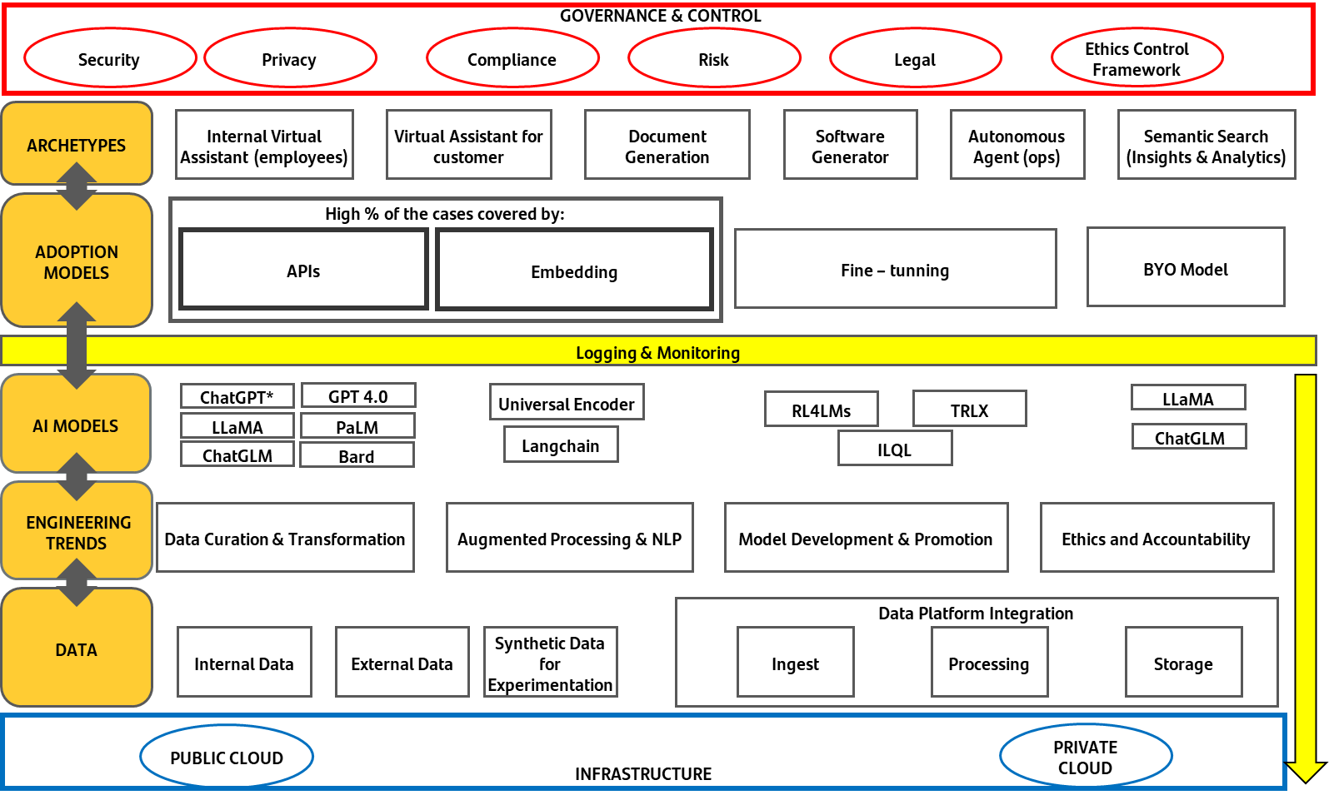

Functional Design
1.6 AI Projects
Identify what type of Archetype, Adoption Model, AI Model, and Cloud Model is being used for the AI.
Attach the AI diagram as well.
AI Focus Area | Risk | Response
AI Model | Lack of proof of trustworthiness and Reliability in AI Model that is providing a Regulatory Function or Capability.
AI Output | Lack of Clear Boundaries and Scope around the AI solution.
AI Data and Input | Lack of evidence that Training Data is collected from Trusted Sources.
AI Application Context | Lack of Human Oversight over any output of AI solution.
AI Model | Lack of evidence that the model is unbiased.
AI Model | Lack of tracking and monitoring of AI model (for Drift and Biasedness and other risks associated with the AI Model)
AI Application Context | Lack of Business Continuity Plan around the AI model in case of Bias, Drift, or other significant problems.
AI Model | Lack of Clear Business Benefits of the AI solution
AI Model | Lack of AI Model documentation
AI Model | The AI Solution is not recommended by the Group AI COE
AI Model | Mismatch between the complexity of LLM Model and the Data Classification as per Santander Generative AI Handbook

Slide 12
Functional Design
1.7 Control Model
Attach Data Risk Assessment here
Risk assessment has been fully completed as part of deliverables delivered in Delivery Hub tool as part of IT Governance methodology.

Slide 13
Technical Design
02

Slide 14
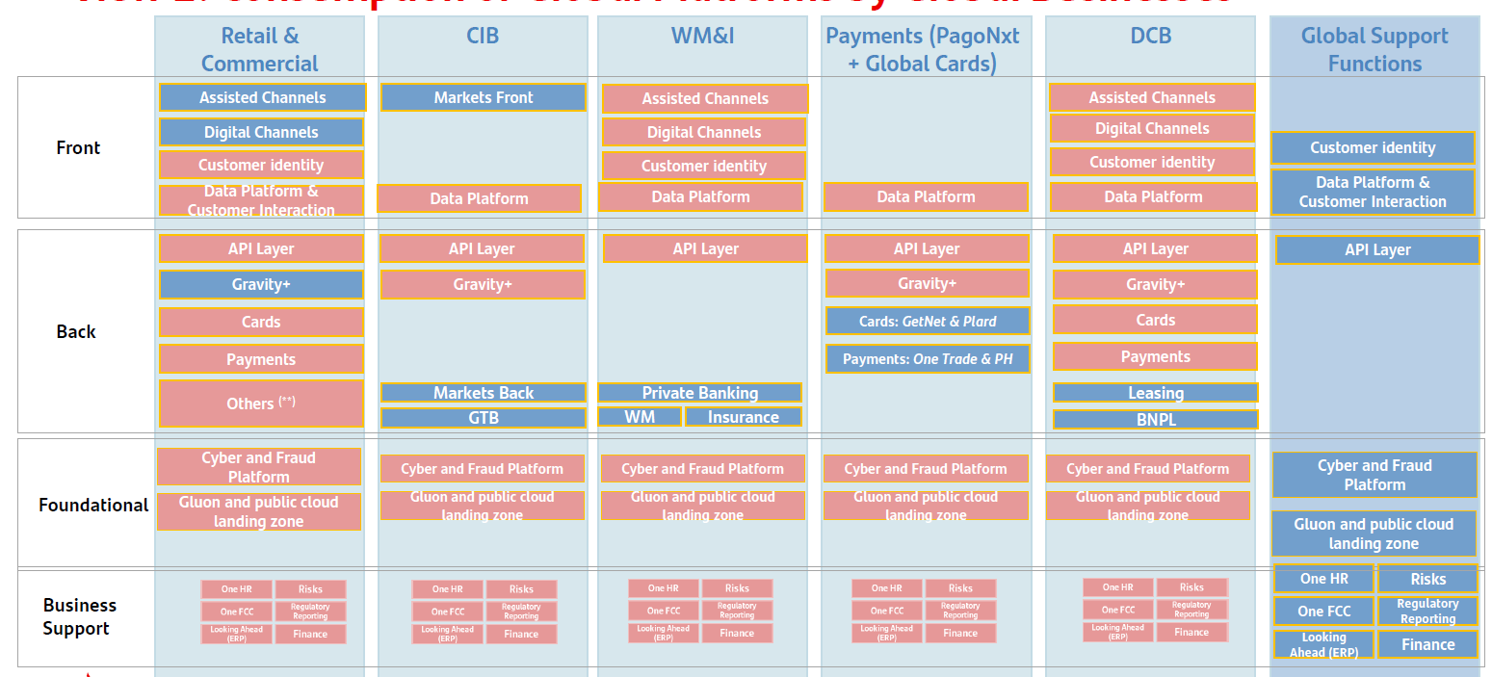
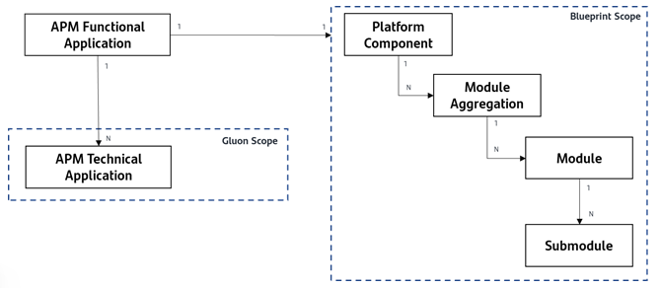
Technical Design
2.1 Architectural Building Blocks
The building block view shows the static decomposition of the system into building blocks (modules, components, subsystems, classes, interfaces, packages, libraries, frameworks, layers, partitions, tiers, functions, macros, operations, data structures, …) as well as their dependencies (relationships, associations, …)
Based on new Santander Global Platform* model:
* https://santandernet.sharepoint.com/sites/SantanderPlatforms

Slide 15
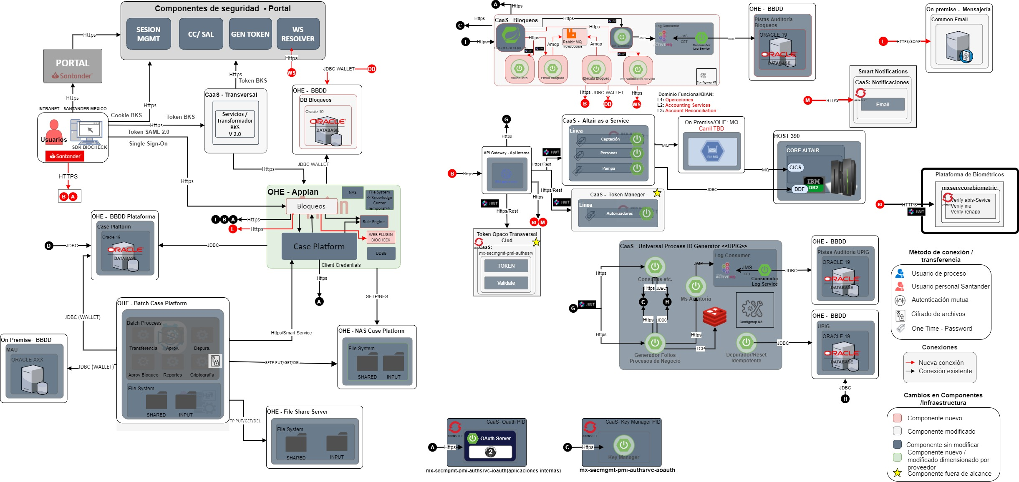
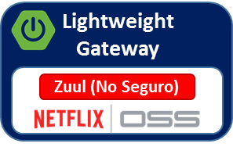



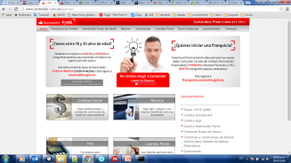


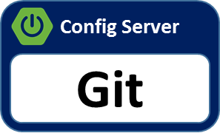

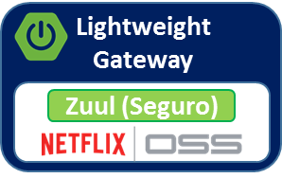


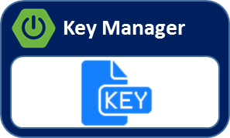



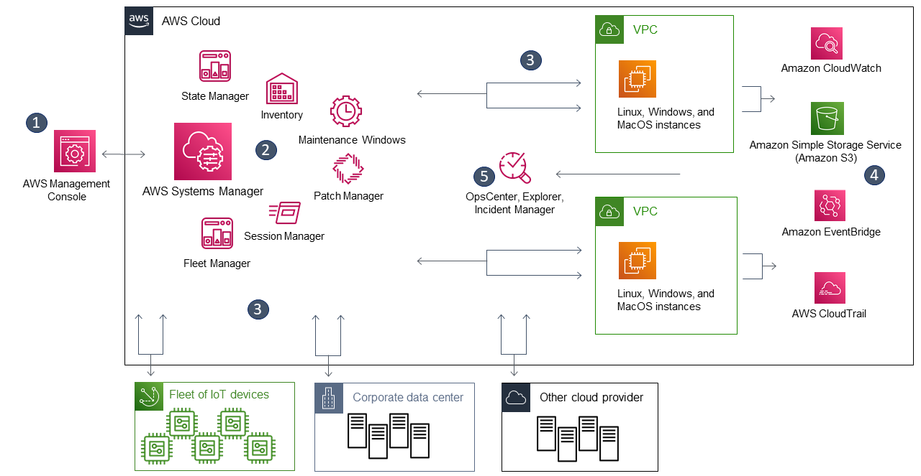

Technical Design
2.2 Technical View
It’s a technical view where show Software components and their relationship. If needed, show the relevant physical infrastructure components. It contains:
Technological Components ( Technical domain (apis, Microservices, data, events...) ) and third-party dependencies, Users
Integrations between them (asynchronous/synchronous, communication protocols, communication security).
Observability (technical solution with focus on logs, traces and metrics),
Deployment platform (private Cloud, public Cloud, on premise)
Red interna BSM
2
Auditoria
BD Formatos Electrónicos
5
Ondemand
Formatos Electrónicos
Almacenamiento
(Expediente)
Ejecutivos en Sucursales
PaaS
Herramienta de Contratos
1
<<Browser>>
Servicios
Repositorio de Plantillas
Lógica Web
Patrón Bimodal
3
Servicios Core
4
IBM OS/390
IDA
CICS
Core Altair
Servicios
Auditoria
Out of Scope
Component to Changed
New Component
Component without change

Slide 16
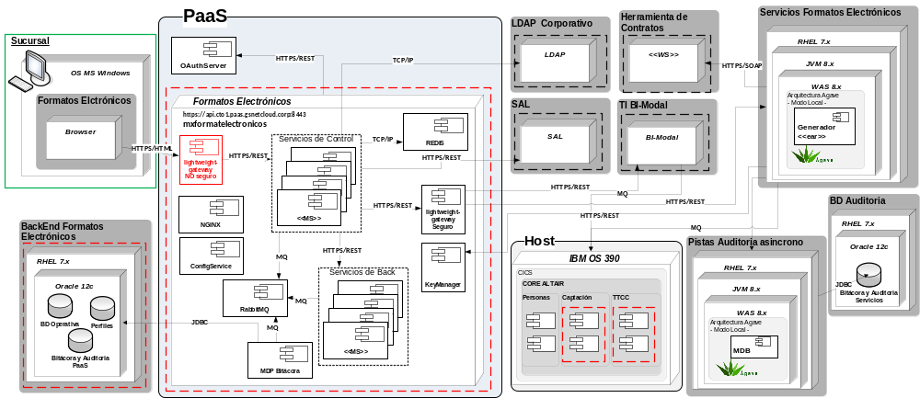
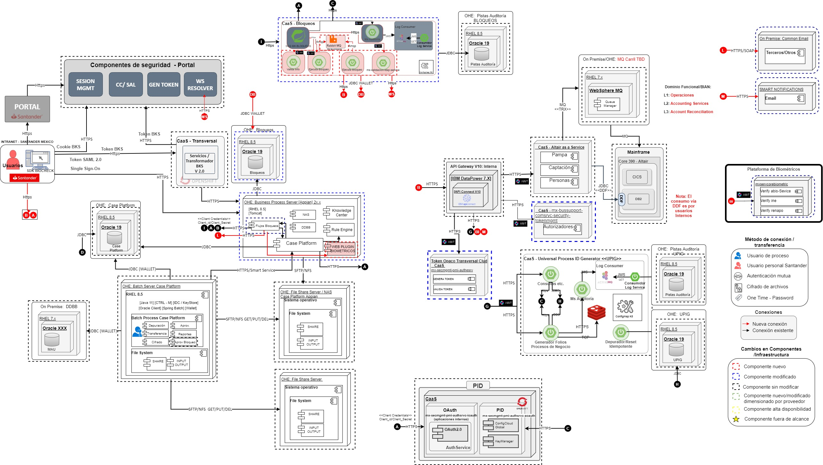
Technical Design
Not Mandatory in the first phase
2.3 Deployment View
The deployment view describes:
the technical infrastructure used to execute your system, with infrastructure elements like geographical locations, environments, computers, processors, channels and net topologies as well as other infrastructure elements and
the mapping of (software) building blocks to that infrastructure elements.
Especially document the deployment view when your software is executed as distributed system with more then one computer, processor, server or container or when you design and construct your own hardware processors and chips.
Highlight the changes and new components
Out of Scope
Component to Changed
New Component
Component without change

Slide 17
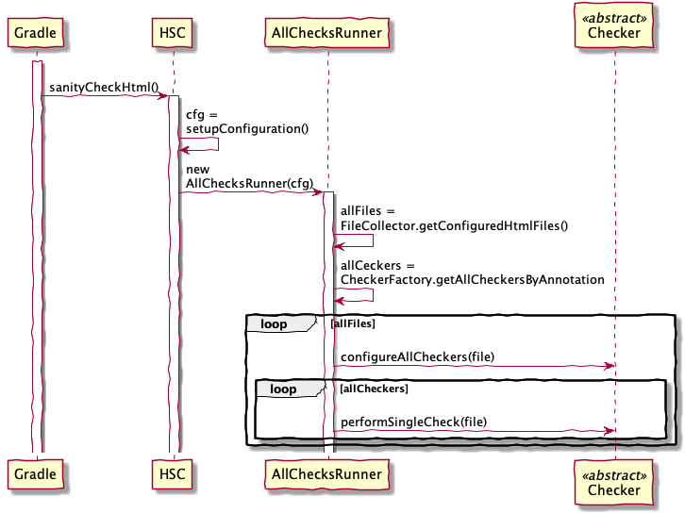
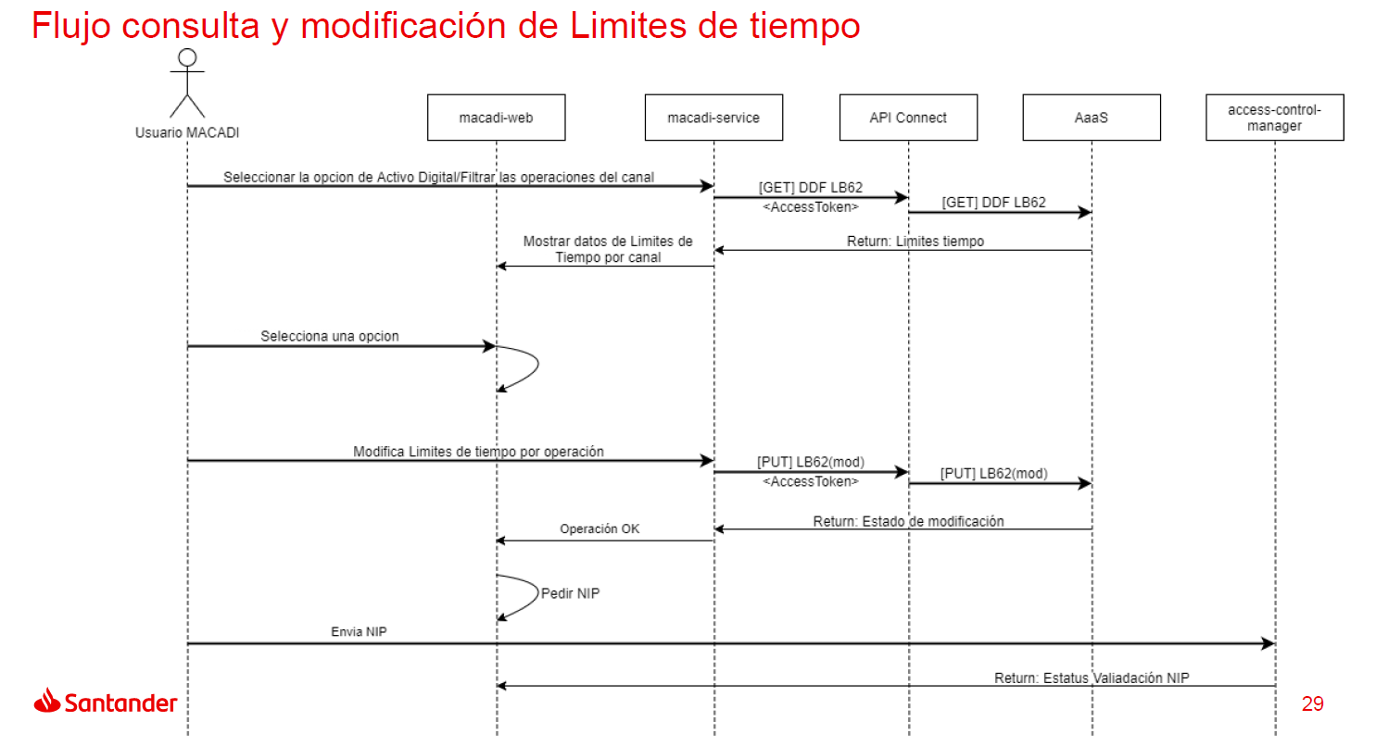
Technical Design
2.4 Runtime View / Sequence Diagram
The runtime view describes concrete behavior and interactions of the system’s building blocks in form of scenarios from the following areas:
important use cases or features: how do building blocks execute them?
interactions at critical external interfaces: how do building blocks cooperate with users and neighbouring systems?
operation and administration: launch, start-up, stop
error and exception scenarios

Slide 18
Technical Design
2.5 Integration – Message/Traffic Flow
List of Message/Traffic Flow
Flow Id | Connection Name | Source | Destination | Traffic type / Content Description | Protocols / Ports | Data Classification | Encryption Method | (E)xisting (N)ew | (I)nternal / (T)hird Party | Data Size
 | Asset control T24 | Asset Control | T24 | Batch | SFTP | Internal | No | Existing | SGTO (intratgroup entity) | Small
 | T24 – DTCC | T24 | DTCC | Online/Batch | SFTP | Confidential | No | Existing | DTCC | Small
 | T24 - Medea | T24 | Medea | Batch | SFTP | Confidential | No |  | NA – BSI local system | Small
 | T24 - Murex | T24 | Murex | Batch | SFTP | Confidential | No |  | SGTO (intratgroup entity) | Small

Slide 19
Technical Design
2.6 Third Party Connectivity Information
If the project or application involves connectivity with a 3rd party vendors, please provide information relevant to the project
Vendor name | Connection status | Connection type | Data exchange
Santander Global Tech (Intragroup Entity) | Existing connection (use an existing connection with the vendor) | Murex: Saas application Asset control | Asset control provides FWD and Fixing Rates to T24. T24 provides trade info to Murex.
DTCC | Existing connection (use an existing connection with the vendor) | Off premises | T24 reports trade info to DTCC so BSI can meet Dodd Frank requirements.

Slide 20
Technical Design
2.7 Data Flow
Data Flow
Please use the format below to document the data flow of the target solution.
Include expected file transfers, ETL jobs, internal database code (e.g. sql procs), and API calls.
If known at this point, include database details (server, database, schema).
FTP
ETL options:
- PWC (Powercenter)
- SSIS
- other (specify)
DB code options:
- SP (Stored Procedures)
- SQLL (SQL Loader)
- other (specify)
Staging A
ETL
7 files
SQLL
FTP
3 files
DB code
Server: xxx ‬
DB: xxx ‬
Schema: xxx
API / Web Service
PWC
Staging B
Database A
DataMart
7 files
SQLL
FTP
5 files
FTP
20 files
PWC
Server : xxx ‬
DB: xxx ‬
Schema: xxx
Server : xxx ‬
DB: xxx ‬
Schema: xxx
Server : xxx ‬
DB: xxx ‬
Schema: xxx
Staging C
Database B
7 files
SSIS
FTP
2 files
SP
FTP
6 files
Server : xxx ‬
DB: xxx ‬
Schema: xxx
Server : xxx ‬
DB: xxx ‬
Schema: xxx

Slide 21
Technical Design
2.8 Integration – APIs
List of new APIs
List of APIs developed as part of this project/reused/including vendor APIs consumed
* To be filled by API Governance Team
API Id | Mega Service Id | Service Domain (BIAN)* | Service Operation (BIAN)* | Layer | Version | # of Operations | Description | Owner Application

Slide 22
Technical Design
2.9 Applications
New Application Only
COMPLIANCE INFORMATION
MEGA Id | Name | SOX | GLBA | IRA Rating
DATA INFORMATION
MEGA Id | Name | Data Classification | NPPI | Data Migration Required Explain Process | PRO Data in Non-PRO Environment

Slide 23
Technical Design
2.9 Applications
New Applications Hosting details – fill out the table for each new application
Application Identification
MEGA Id
Application Name
On Premises | Yes/No
Service Model | IaaS/SaaS/PaaS / IaaS affiliate/SaaS affiliate/PaaS affiliate
Application Provider
Hosting Entity
Vendor Service ID (Hiperos)
BIA RTO / BIA RPO | This it the Business Requirement – it should be defined in Business Requirement Document (BRD)
Licenses Ownership (Corporate - SHUSA-SBNA-SC-SIS-SBNY-BSI)
Hosting Service (4th PARTY)
Data Location (Region and Zone)
DR Location (Region and Zone)
Application Resiliency checked by Engineering Team | Application Level / Database Level
Cloud Deployment Information
Cloud Deployment | Yes/No
Cloud Deployment Model
Santander Cloud Landing Zone (Entity and Region)
Cloud Provider
Tenancy Model
Data at rest Encryption Method
Data in Transit Encryption Method
Key Management Method | None-KMS-HSM
Santander Control Keys | Yes/No

Slide 24
Technical Design
2.10 User Management
New Applications Security Details – fill out the table for each new application
Insert Information Security Assessment Report (ISAR) Approved in this page
User Management
Provide information related to user management.
APPLICATION SECURITY
Types of Users | (Admins, Back Office, Service Account, External Customers)
SAILPOINT Integration | Yes/No (Global / Local)
SIEM Integration | Yes/No (Global / Local)
Audit Log Feature Available | Yes/No
User Identification | User Locality | Authentication
List all the user groups who will access the systems. (i.e Branch Executives, Branch Tellers, Branch Managers, Back Office Employees, Underwriters, Customers,) Identify connectivity requirements to help determine user profiles. Confirm whether there are any network latency or security concerns. | List the locations of the users who will access the systems. (i.e. Department, Branches, Corporate Buildings, Contact Center, Entity, and geographics globally in addition to the internet access. | SSO (Ping Federate), Active Directory, AzureAD, Local Credential

Slide 25

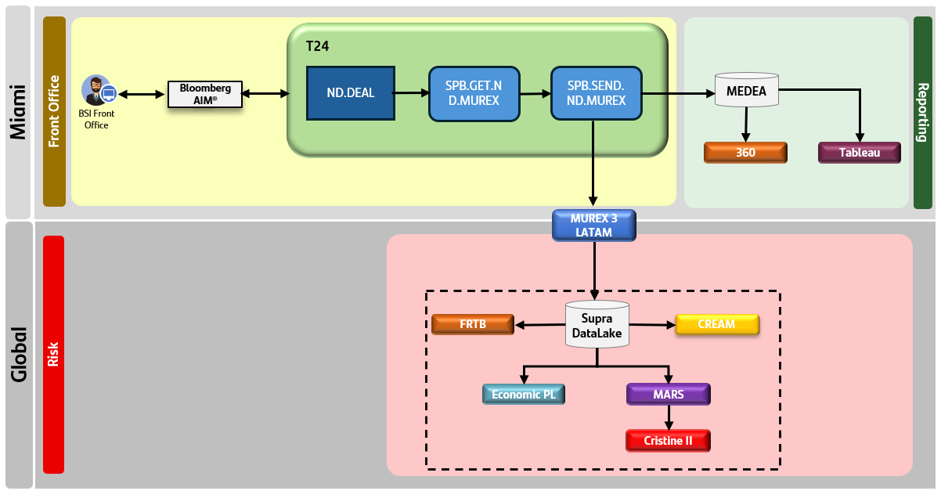
Technical Design
2.11 Security Architecture Diagram - Target
Functional description
Connections
T24 – Medea : Daily – in batch by EOD.
  Existing connection. No new files. Only incremental information in existing files.
  Purpose: Information sent to Medea for PnL calculation/ recognition and Client statment purposes.
T24 – Murex 3 Latam: Daily – in bacth by EOD,
  Confidential information. Non PPI information (non-sensible info). Only trading info.
  Purpose: Aditional information for NDF (in same way as FX Spot, FX Forward and FX Swap) is sent to MX3 Latam by using a call to SCIB API. Call is REST HTTPS with JWT/Oauth2. Then Murex send the ACK to T24 (via IIB – API Connect) and there is a recon report confirming that ACK has been received for all contracts. In case of any mismatch, MO received the alert and proceed with the remediation. Any fail on this process does not make any impact in the client.
T24 – DTTC: Daily, via SFTP, through MIA RELAY online and in batch by EOD.
Confidential information. Non PPI information (non-sensible info). Only trading info.
Purpose: Trading information for NDF (in similar way as FX) will be automatically uploaded by T24 into DTCC to meet Dood Frank regulatory requirements. Automatic uploading will be done by using existing connection made in the past for FX, for same purpose. This existing connnection only requires updating in terms of port opening and servers.
Asset Control – T24: Daily by EOD , In bacth, via SFTP trhough MIA RELAY
Confidential information. Non PPI information (non-sensible info). Only Market info (rates). Only Reception in BSI It is considered confidential since there are some process in Global to ensure this info is accurate.
Purpose: BSI Miami require to received Fixing rates from Asset Control group system using existing connectivity made for FX. For FX, BSI is receiving FWD rates that are needed for MTM valuation .Due to the nature of the product, NDF requires FWD rates for MTM valuation (same as FX) but also Fixing rates that is a key input used to calculate settlement. Fixing rates will be delivered by Asset Control to BSI by sending a new file built for this purpose and using existing connectivity (nothing required in terms of connection). Note that, although this fixing date to be received is critical for Settelment process there will be a complementary control to mitigate the risk that will ensure process not fail. Control will be automatic and will identify any missing Fixing rates when expected, so Product support team can fill in the data manually in the system to cover the issue. ownership to input this data in the system manually.
1
DTCC: TPP
3
2
Reporting
1
3
5
Product Support
2
6
4
PIF
Asset control
4
Risk
MOI Reports
MOI Reports: MEGA: 5975
BSI new consumer
User´s accesses
There is“De Minimis” threhold that BSI cannot exceed (Business limit agreed with SCIB Business and with Regulatory Compliance Global) that is calculated based on NDF activity. Due to that, consumption of lmit should be control to ensure 1) correct calculation and 2) Monitoring. To meet these two objectives, two new accesses are required for BSI Users (Product support team).
BSI user accessing to PIF: BSI Users uploads ONLY Murex IDs (No PPI info) of trades that should be removed (adjustment) from Consumption calculations. PIF is part of the solution of MOI reports in bullet 6) below.
https://rdamac.aacc.gs.corp/TRDEFI_ENS/EarEstatico/TRDEFI_ENS/BtoChannelDriver.ssobto?dse_operationName=inicioPortal
BSI usser accesing to MOI reports App (Santander Corporate App):, Product support will require accesss to MOI reports, to visualize the limit consumpition after the adjusment to ensure it has been done correctly. MOI report is an existing app in the group (MEGA: 5975) currently used b SHUSA entitiies. BSI has been setup as consumer of this app.
5
25
6

Slide 26
Macro Architecture
Technical Design
BSI
T24
GENERATE AND SEND FILE
SFTP
SFTP
DTCC
GENERATE AND SEND THE FILE
SEND THE FILE
ND. DEAL
BATCH SERVICE
SAN GLOBAL
SELECT NDF
DO MAPPING
GENERATE JSON MSG
UPDATE FIXING RATES
SFTP
MIA-RELAY
SFTP
ASSET
CONTROL
UPDATE FIXING RATES
SEND FIXING RATES
MUREX
DO
HTTPS
POST
GET JW TOKEN
SEND JSON MSG
HTTPS
POST JSON MSG
API
CONNECT
IIB/ACE
HTTP
UPDATE STATUS
IF ADAPTER
SEND ACK
HTTPS
T24 / Murex
Murex call to an API deployes in API Connect.
API Connect receive the call in an HTTPs port.
It receives Murex’s payload, verifies the authentication and call the correspondent endpoint in IIB forwarding the Murex’s payload previously received.
IIB/ACE updates in NDF table located in T24 by using IF adapter
TECHNICAL SOLUTION
Asset control / T24
ASSET CONTROL generates the fixing rates file
Asset Control places the fixing rates file in MIA-RELAY using SFTP
T24 connect to MIA-RELAY by SFTP and downloads the fixing rates file
T24 process the fixing rates file and update the rates in the ND.DEAL’s
T24 / DTCC
T24 generates the file.
T24 places the file in MIA-RELAY using SFTP
MIA-RELAY send the file to DTCC by SFTP

Slide 27
Technical Design
2.12 New Technologies
List of New Technologies
List of new technologies
Solution | Vendor | Description | Version | Domain | Subdomain | Deployment Model | Service Model | Entities
 |  |  |  |  |  | OHE / AWS / AZURE / Other Cloud | On-Premises / SaaS / IaaS / PaaS | SBNA / SCUSA / BSNY-SIS / BSI

Slide 28
Technical Design
2.13 Public Cloud Native Services in Santander Landing Zone
List of New Public Cloud Native Services in Santander Landing Zone
List of new Public Cloud Services
Public Cloud Provider | Component Name* | Technical Information (Resource Type**) | Description | Service Classification | Technology
*Link to AWS Cloud Services https://aws.amazon.com/products/?aws-products-all.sort-by=item.additionalFields.productNameLowercase&aws-products-all.sort-order=asc&awsf.re%3AInvent=*all&awsf.Free%20Tier%20Type=*all&awsf.tech-category=*all
**Link to AWS Resource Type https://docs.aws.amazon.com/config/latest/developerguide/resource-config-reference.html

Slide 29
Process Design
03

Slide 30
Process Design
3.1 Process Objective
Describes the processes of the solution in a more detailed level, the specific design principles that need to be followed, the lifecycle, and the description of the process from start to finish including: process design, phases, functional events, tasks, components, participants, necessary tools, key metrics, manual interventions, and exceptions.
Provides a brief description based on goals, timeline, and priority:
Key objectives: Consider what key performance indicators or business objectives your process is trying to achieve.
Stakeholders: Though you may not know specific individuals just yet, consider which teams will be working together.
Timeline: You can estimate the process scope and timeline for completion with the critical path method.
Priority: Determine how important this process is to implement compared to other projects and objectives your team is working on.
Process Objectives
Insert new orders passing all pre-trade check and then, execute the order, provide the client with a client confirmation, provide Medea with information for Banker recognition and Clients statement pruposes, provide Murex with trade information to comply with Market Risk and Credit Risk global requirements and provide DTCC with trade info to comply with Regulatory requirements. In addition to that, give facilities to Finance and Risk to allow them to monitor the product during the lifecycle of the trade and apply fixing rates and do calculation when fixing date and settlement date are reached out.
Main capabilities of the solution:

Slide 31
Process Design
3.2 Process Roles - RACI
List all the Roles (a Role is a descriptor of an associated set of tasks; may be performed by many people; and one person can perform many roles) and assign all the Activities with Roles in the RACI Matrix (RACI Matrix is a model that describes the participation by various roles in completing tasks or deliverables).
ACTIVITIES | Commercial | BSI Treasury | BSI Risk | BSi Operations | Product Support | Compliance
Pre-trade checks | R | I
Monitoring of REC Consumption |  |  | A
DTCC reporting monintoring |  |  |  | R |  | I
Banker Recongmotop | A
T24-Murex Recon |  |  |  |  | A
Control of missing fixing |  |  |  |  | A
Reporting to RAC Global |  | I |  |  | A | I

Slide 32
Process Design
3.3 Process Flowchart
To build an effective flowchart, integrate process steps, inputs, outputs, shared docs, and stakeholder details, complementing these with screenshots for added impact. Then, all you have to do is neatly lay out each step in sequential order.
DTCC: TPP
3
Reporting
1
5
Product Support
2
6
4
PIF
Asset control
Risk
MOI Reports
MOI Reports: MEGA: 5975
BSI new consumer
Note that Flowchart has been updated in Blueworks

Slide 33
Infrastructure Requirements
04

Slide 34
Infrastructure Requirements
4.1 Volumes
Provide all the relevant volumes
Metrics | Total
Users of the solution (List of Roles and number of User per Role) | Lending activity to be monitored on the JPM platform that’s already being used (new screen to be enabled)
Average Requests per Day | 0
Peak Hour Requests (during a time range) | NA
Annual growth (%) of Requests | NA
Metrics | Total
Access x Day (users can have more than 1 access)
Annual growth (%) of Users
Service hours

Slide 35
Infrastructure Requirements
4.2 Data Sizing Information
Service
Files (Current Peak Volume/Day)
Specify the number of file systems helps plan. The number of filesystems helps plan for backup/restore and configuring control M jobs. Also shared storage based on NAS or SAN are decided depending on the criticality and latency requirement of the application.
Storage Identifying this information will help with the storage sizing for these files.
Specify the # of files per day/month.
Specify the # of files per day/month
Approximate size per day/month.
Specify file/data retention period in months/years.
Service | Volume
Database This information is critical input into planning for database sizing. The size influences method of backup and need for database replication. If the database is too large, partitioning is important for efficiency and meeting required response time.
Specify the # transactions queries per day.
# of tables and rows in the tables
Record size
Retention period
Size of partition if database partitioning is required.

Slide 36
Infrastructure Requirements
4.3 Data Handling Information
Specify all information related to managing non real-time data below.
Service | Details
Data Retention Period. The data retention period will help plan for data archive, managing content and how they are accessed when needed.
Data Purge Specify the procedure to move the data offline and/or how will the data be purged..
Archived Data Access Instructions Provide the archived data instructions.
Content Management Solution Specify the content management solution.

Slide 37
Infrastructure Requirements
4.4 Reporting
Specify information related to reporting.
Service | Service Description
Method of Report Generation
Batch - Schedule for this report generation. Online - Specify impact on the performance due to report generation, if yes, describe how it is handed.
Reporting Type
Specify if this is a closed & customized report. It is important to understand how the customization is done and how it is promoted from DEV to PRE/PRO. Open - May be in the form of an UI, where the user makes a selection of criteria for the desired report, live on the system. Closed-In the case of closed reporting criteria is predetermined and cannot be changed at real-time.
Report Orchestration
Specify if there is a special requirement for this tool.
Reporting Server
Specify if there is dedicated server needed.

Slide 38
Infrastructure Requirements
4.5 Workstation Requirement
Provide information related to workstations (clients)
Requirement | Description
Connection to New System
Specify whether it is a thick client, web-browser based, and browser versions. Specify other types of connections so it will help with overall security assessment. Determining whether it is external and identify if there is a UI & how are the credentials passed.
Remote Desktop Specify whether Remote Desktop is required for the end clients.
Special Software needed
Please list all special installation requirements and versions. (ex. Java, .Net Framework, Editors (i.e. SAS, Tableau), and special libraries)

Slide 39
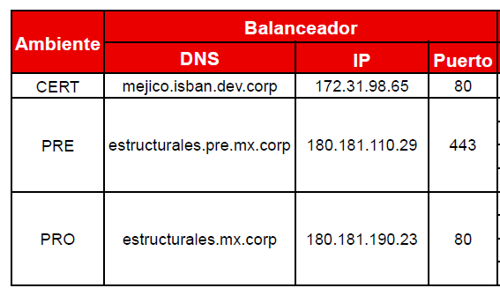
Infrastructure Requirements
4.6 Application Availability
Provide information regarding the Farms / Load Balancing
Provide information regarding Application Availability
Provide any specific requirement for the different functional layers (for example, if the elements of the specific layer need to be active/active or active/passive, if a DB synchronous copy is needed or a file share is necessary)
Requirement | Description
Session Persistence List the session persistence. Each connected will be directed to the next available server regardless of where the previous connection went to. | No Persistance – Stateless Persistance – Stateful Source IP Affinity - The load balancer will keep track of source IP addresses. HTTP Cookies -. Session persistence by cookie.
Timeouts | Provide the timeout due to user inactivity or connection/response time exceeding the set time. Application Session timeout Persistence timeout.
Availability Monitoring | Specify whether a health check will be tested by the balancer periodically. Provide/define the URL
Requirement | Description
Load Balancing
Front servers
Business Logic or Application Servers
Database
Storage
Communications or Network infrastructure

Slide 40
Infrastructure Requirements
Updated: Hardware Specification (hard Requirement)
4.7 Infrastructure Components
Please include all relevant Infrastructure components considering OnLine and Batch solutions
Component | Description | New / Changed / No Changed | Infrastructure Layer | Hardware Specification | Mandatory Y/N
Ctrl-M | Orchestrator | New | Web App xxx
Oracle DB | Application Database | Changed | Web App xxx
MOM (MQSeries) | Message middleware | No changed | Web App xxx
WAS | WebSphere Application Server | New | Web App xxx
Email | SMTP Servers | New | Common Email
FileSystem | FileSystem | No changed | Web App xxx
Virtual Machine RHEL | Web/Application Server | New | Web App xxx | 2 CPU 4GB RAM 40 GB Local File System | Y

Slide 41
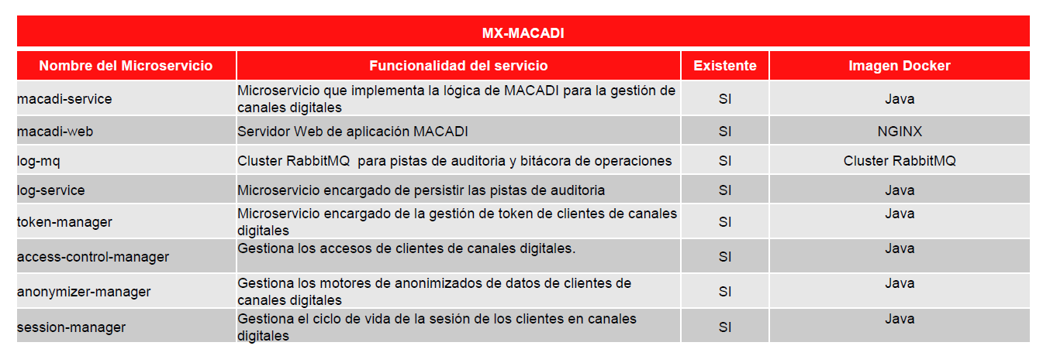
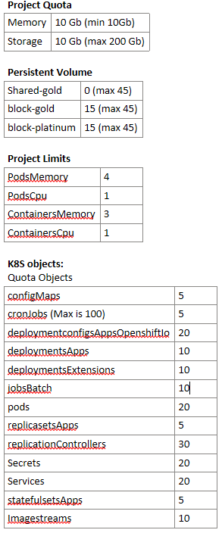
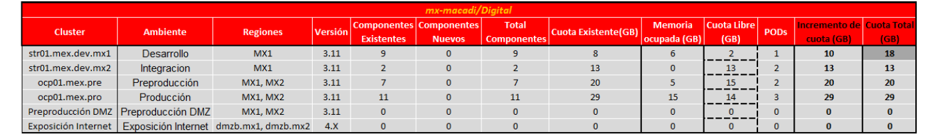
Infrastructure Requirements
4.8 CaaS Infrastructure
List of Microservices
Namespaces specifications
Project Size (S, M, L, XL) based on: Project Quota, Persistent Volume, Project Limits, K8S objects

Slide 42
Infrastructure Requirements
4.9 Special Requirements
Special Hardware/Software requirements
Please specify any out of the box requirement for this application/solution to work. (This is to specify if there is any special instruction related to the application that has not been covered before)

Slide 43
Infrastructure Requirements
4.10 Cyber Resiliency - Application Level
This criteria focuses on the concept of resilience – the ability to “bounce back” from an adverse event. This is required in order to identify the measures that have been taken or considered during the planning stage of the application development/configuration. The primary focus is on the ability to fully or partially withstand a cyber event. Alternatively, should there be an impact, identify the course of action to restore the application with least impact or delay. Cyber resiliency must be addressed at the application level and also at the infrastructure level (every tier) which can be further defined in the infrastructure design.
Requirement | Description
Application Level
Provide the CND Compatible, Distributed computing/redundancy, and the details related to the Provision & configuration automation for quick and easy restoration. Distributed computing/redundancy (i.e Active-Active application cluster capability) and (i.e. Microservices Architecture) CDN Compatible (i.e. DDOS mitigation using Akamai/CDN) Provision & configuration automation for quick and easy restoration
Database Level
Specify the recovery from data loss/corruption: Recovery/rollback using transaction Recovery from backup Reconstruct from original source (DataMart)

Slide 44
Infrastructure Requirements
4.11 References
Name | Description / URL / Attachment

